Slide 1
Michal Boleslav Měchura
Masaryk University, Brno, Czech Republic

Slide 2
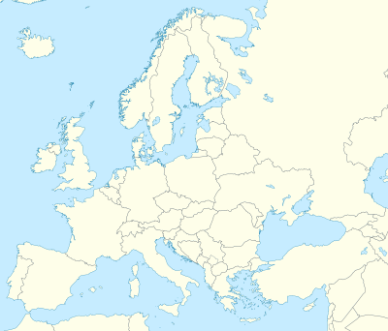


Slide 4
My work
lexonomy.eu
  Open-source dictionary writing system
dictionaryportal.eu
  Europan Dictionary Portal
teanglann.ie
  Irish Dictionary and Language Library
logainm.ie
  Placenames Database of Ireland
téarma.ie
  National Terminology Database for Irish
etc…

Slide 5
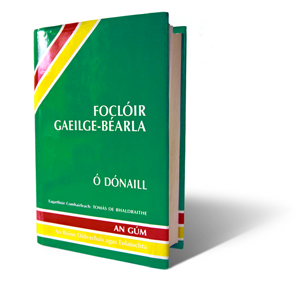
Foclóir Gaeilge-Béarla (FGB)

Slide 6
Foclóir Gaeilge-Béarla (FGB)

Slide 7
Foclóir Gaeilge-Béarla (FGB)

Slide 8
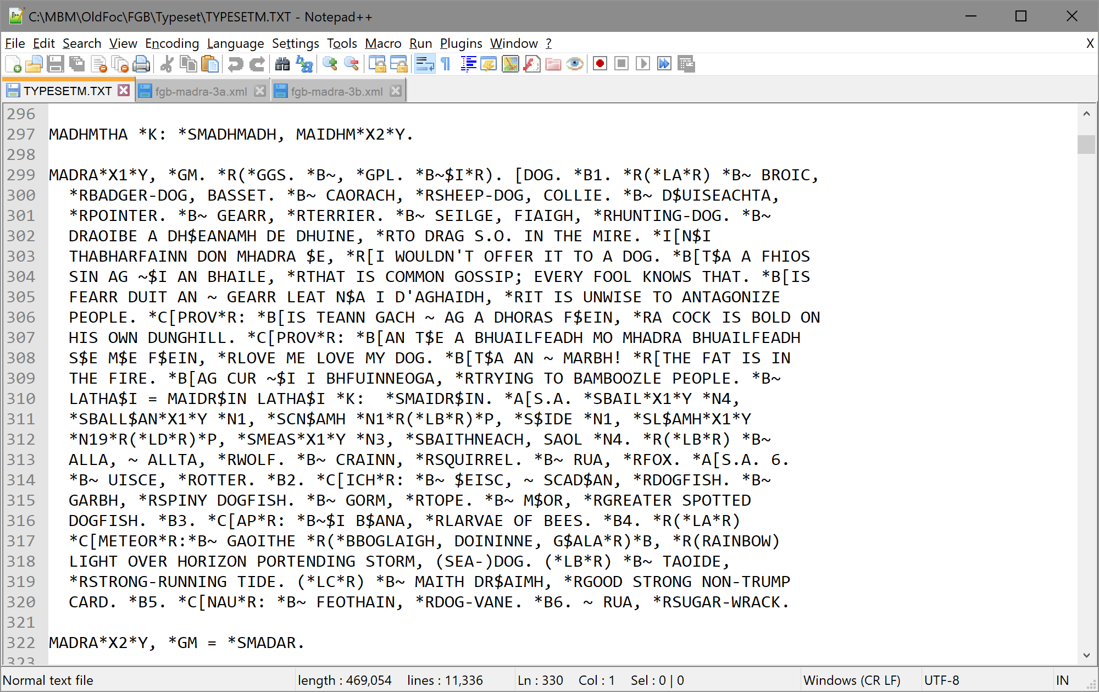
FGB retrodigitization (1/4)

Slide 9
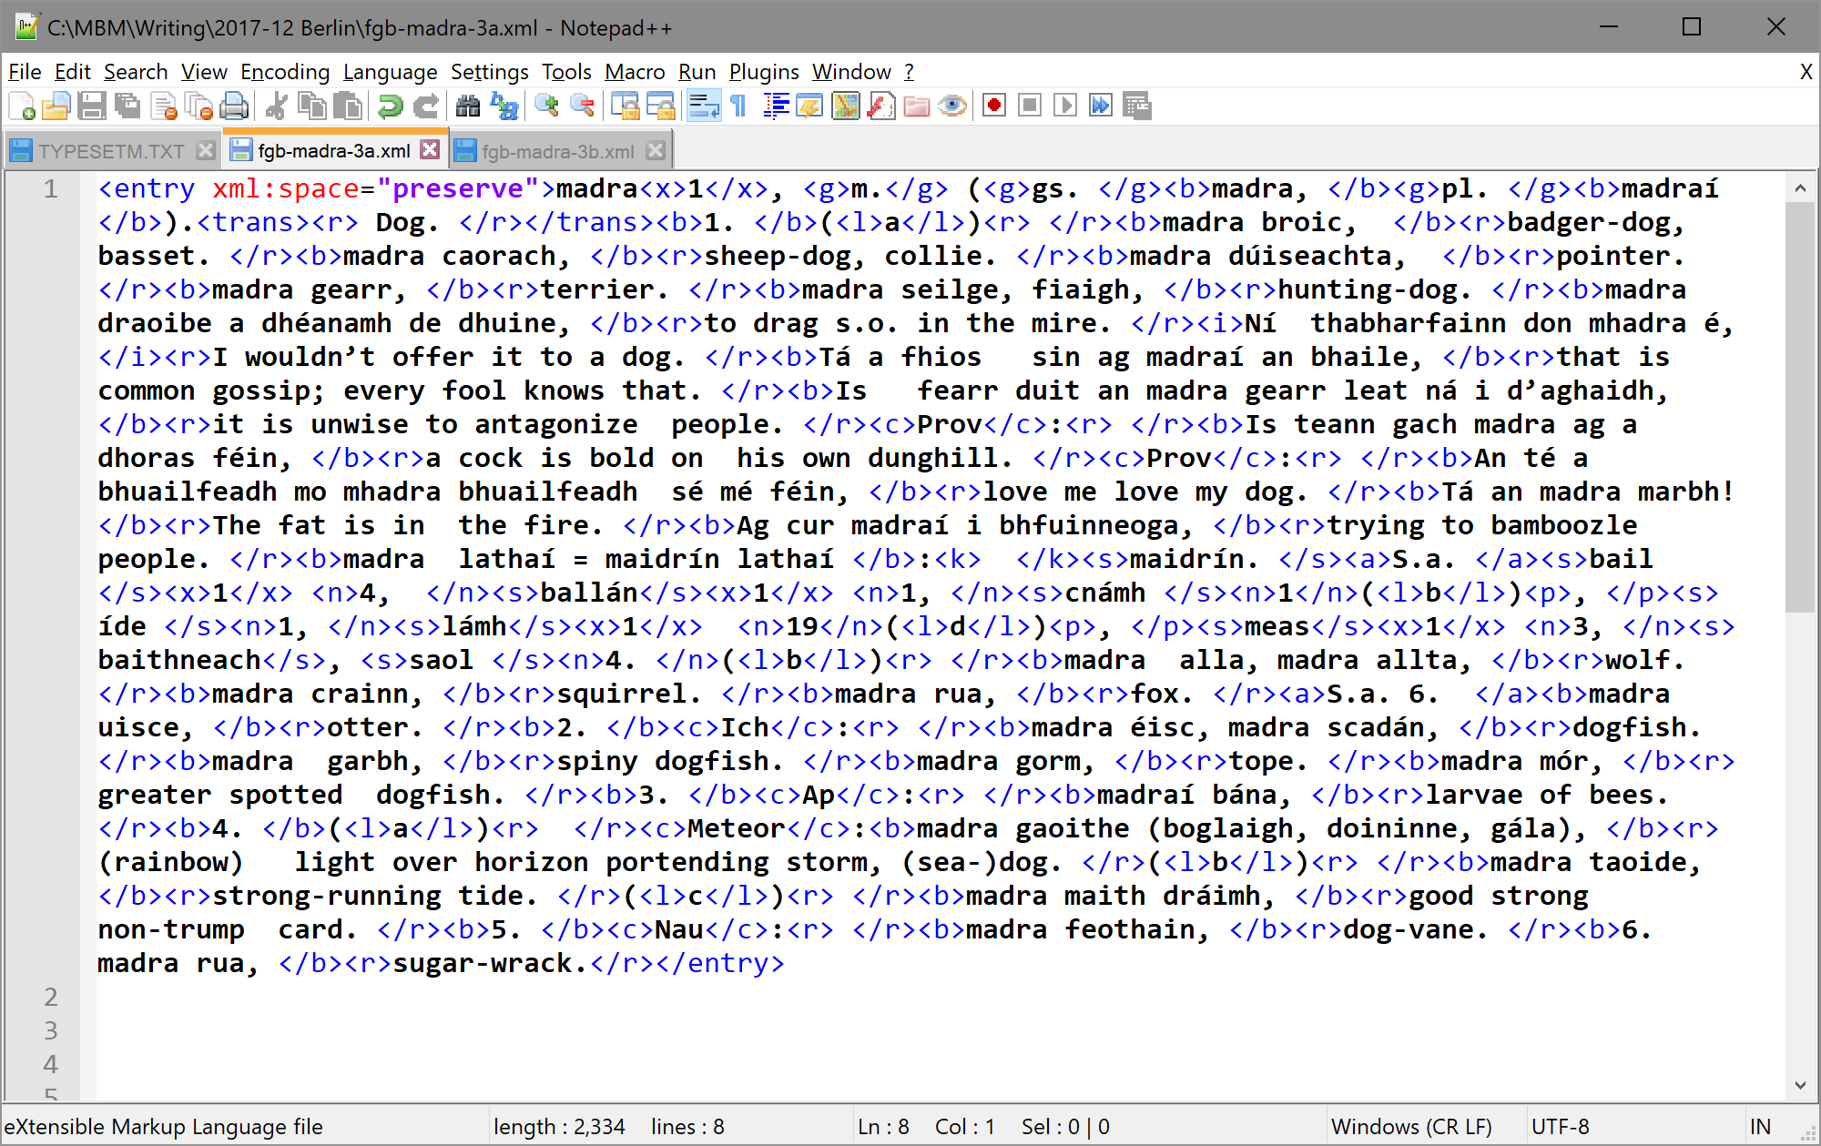
FGB retrodigitization (2/4)

Slide 10
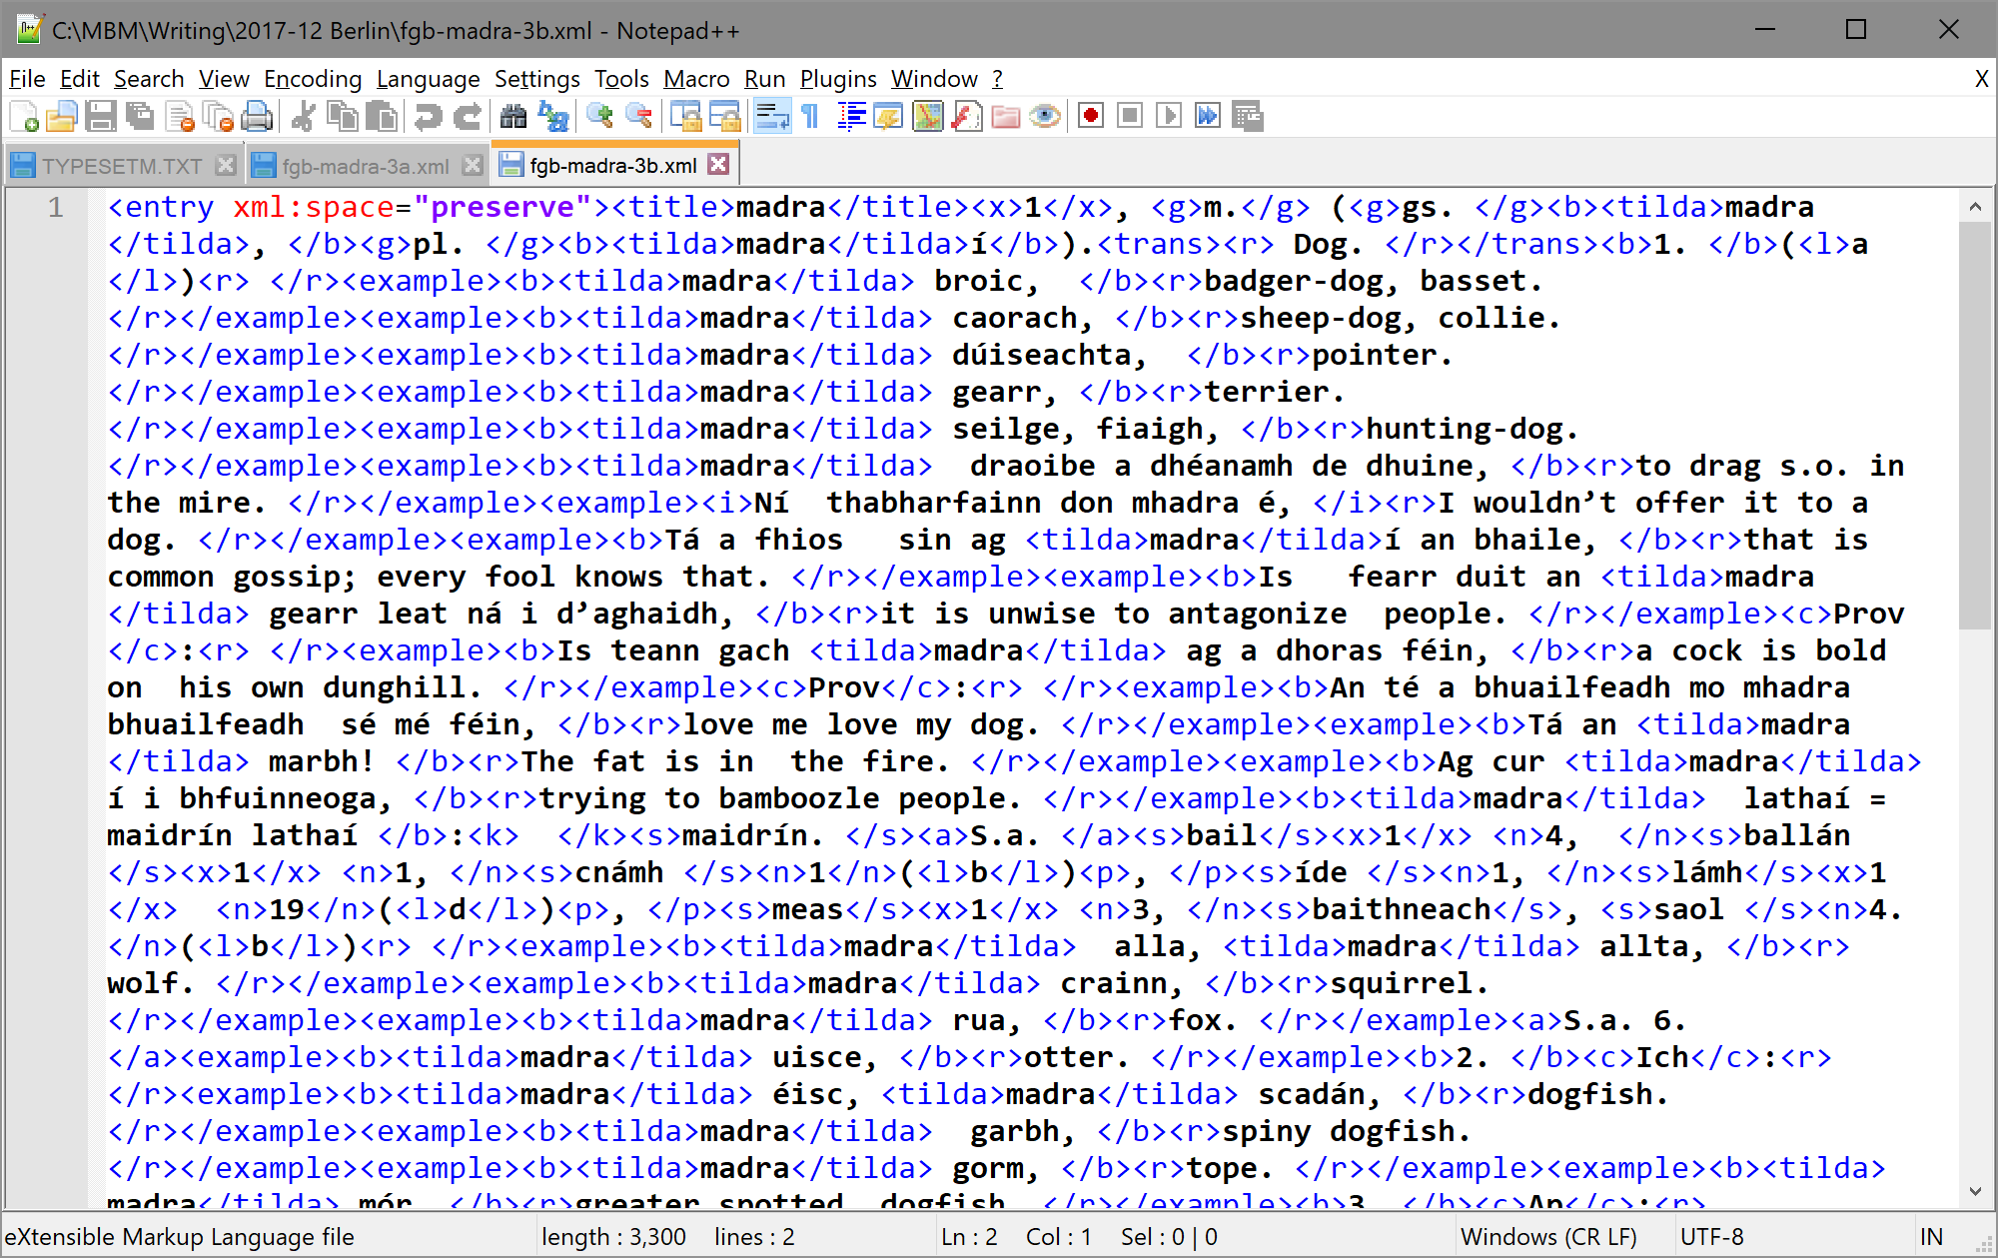
FGB retrodigitization (3/4)

Slide 11
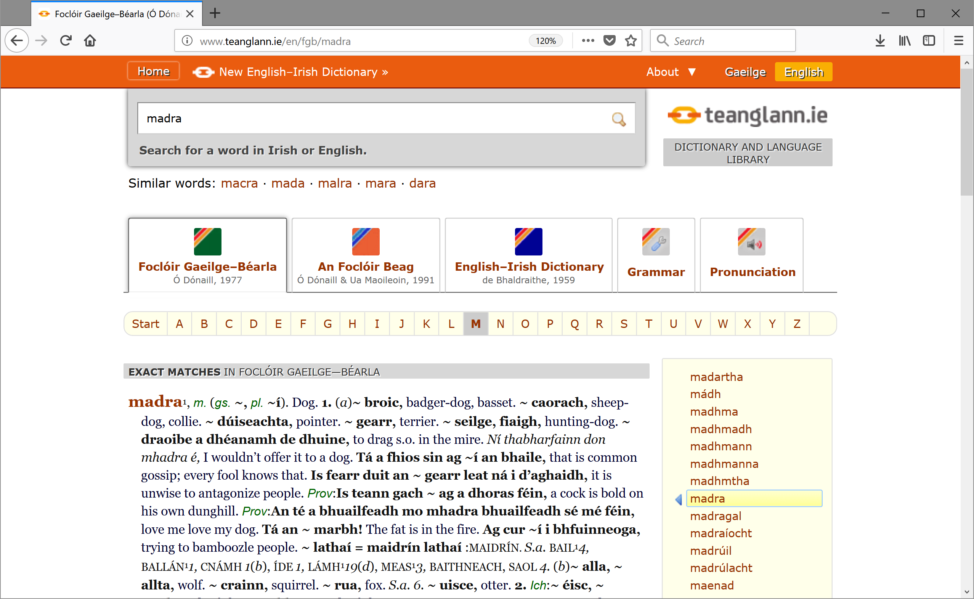
FGB retrodigitization (4/4) www.teanglann.ie

Slide 12
My goals for this week
Get friendly with TEI
Re-encode FGB in TEI

Slide 13
My goals for this week
Get friendly with TEI
Re-encode FGB in TEI

Slide 14
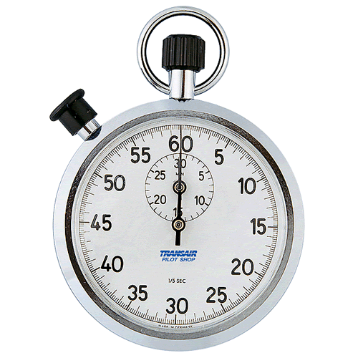
Time’s Up!
About your speaker:
  Name: Michal Boleslav Měchura
  Institutions: Masaryk University,
  Dublin City University, Foras na
  Gaeilge
  Website: www.lexiconista.com
  Quick bio: Blah blah blah blah blah blah blah blah blah blah blah blah blah blah blah blah blah blah blah blah blah blah blah blah blah blah blah blah blah blah blah blah blah blah…

